Slide 1


OPEN
DATA
SCIENCE
CONFERENCE
@ODSC
Boston | April 30 - May 4, 2019

Slide 2
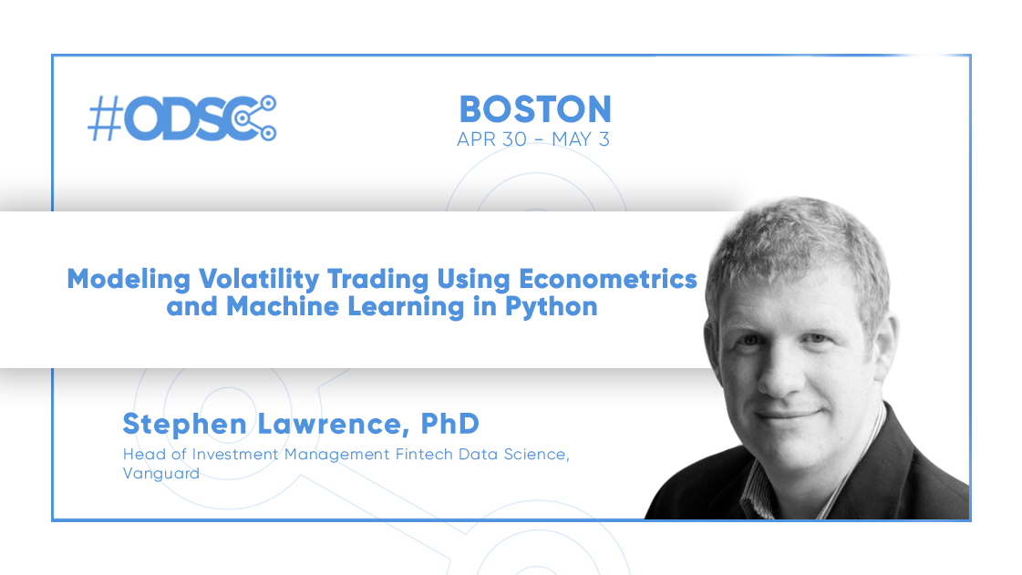

Slide 3
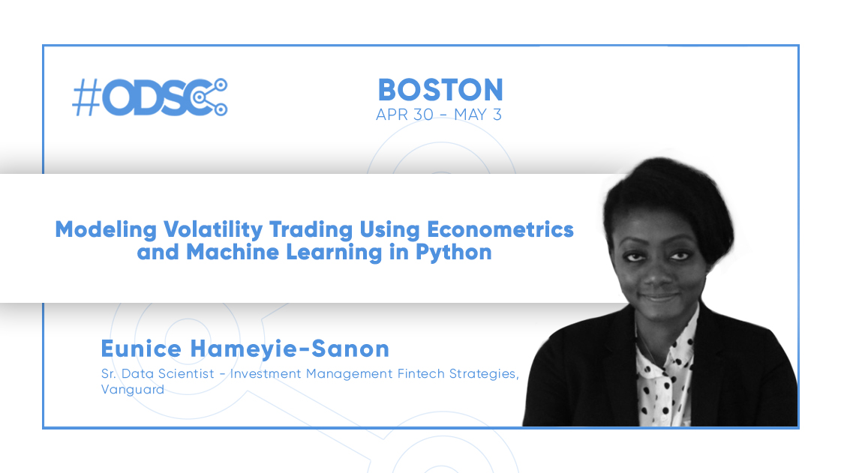

Slide 4
Important Information
The opinions and materials presented in this training session are solely those of the authors and do not represent those of The Vanguard Group or its affiliates.
All code and materials are purely for informational and illustrative purposes. They should not be considered investment advice and come with no warranty.
You are using this code at your own risk.

Slide 5

Prerequisites for the Training Workshop
To access the materials in this presentation, please visit:
https://github.com/fintechsteve/modeling-volatility
To successfully complete this training you will need either:
Python with Jupyter Notebooks (e.g. Anaconda)
-or-
An account on Google Colab
Packages used include: pickle, cloudpickle, numpy, pandas, matplotlib, seaborn, scipy and bashtage/arch

Slide 6
Workshop Overview and Timeline
0900 – 0915 Introductions, Setting up the environment and project background
0915 – 0945 Part 1: Working with return data in Python Eunice Part 2: Visualizing Timeseries Data
0945 – 1000 Part 3: Setting up the Modeling Framework Steve
1000 – 1030 Part 4a: Understanding Turbulence Signals Steve Part 4b: Creating Turbulence Models
1030 – 1100 Break
1100 – 1145 Part 5a: Understanding GARCH Estimation Steve Part 5b: Creating GARCH Models
1145 – 1230 Part 6a: Direct attempts at machine learning Eunice Part 6b: Combining methods Steve
1230 – 1300 Conclusion and Q&A Steve/Eunice

